Slide 1
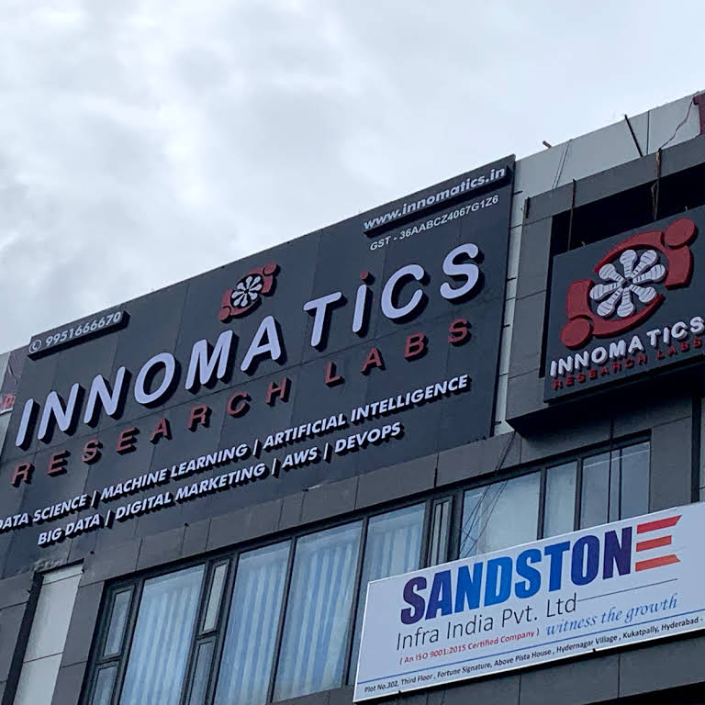
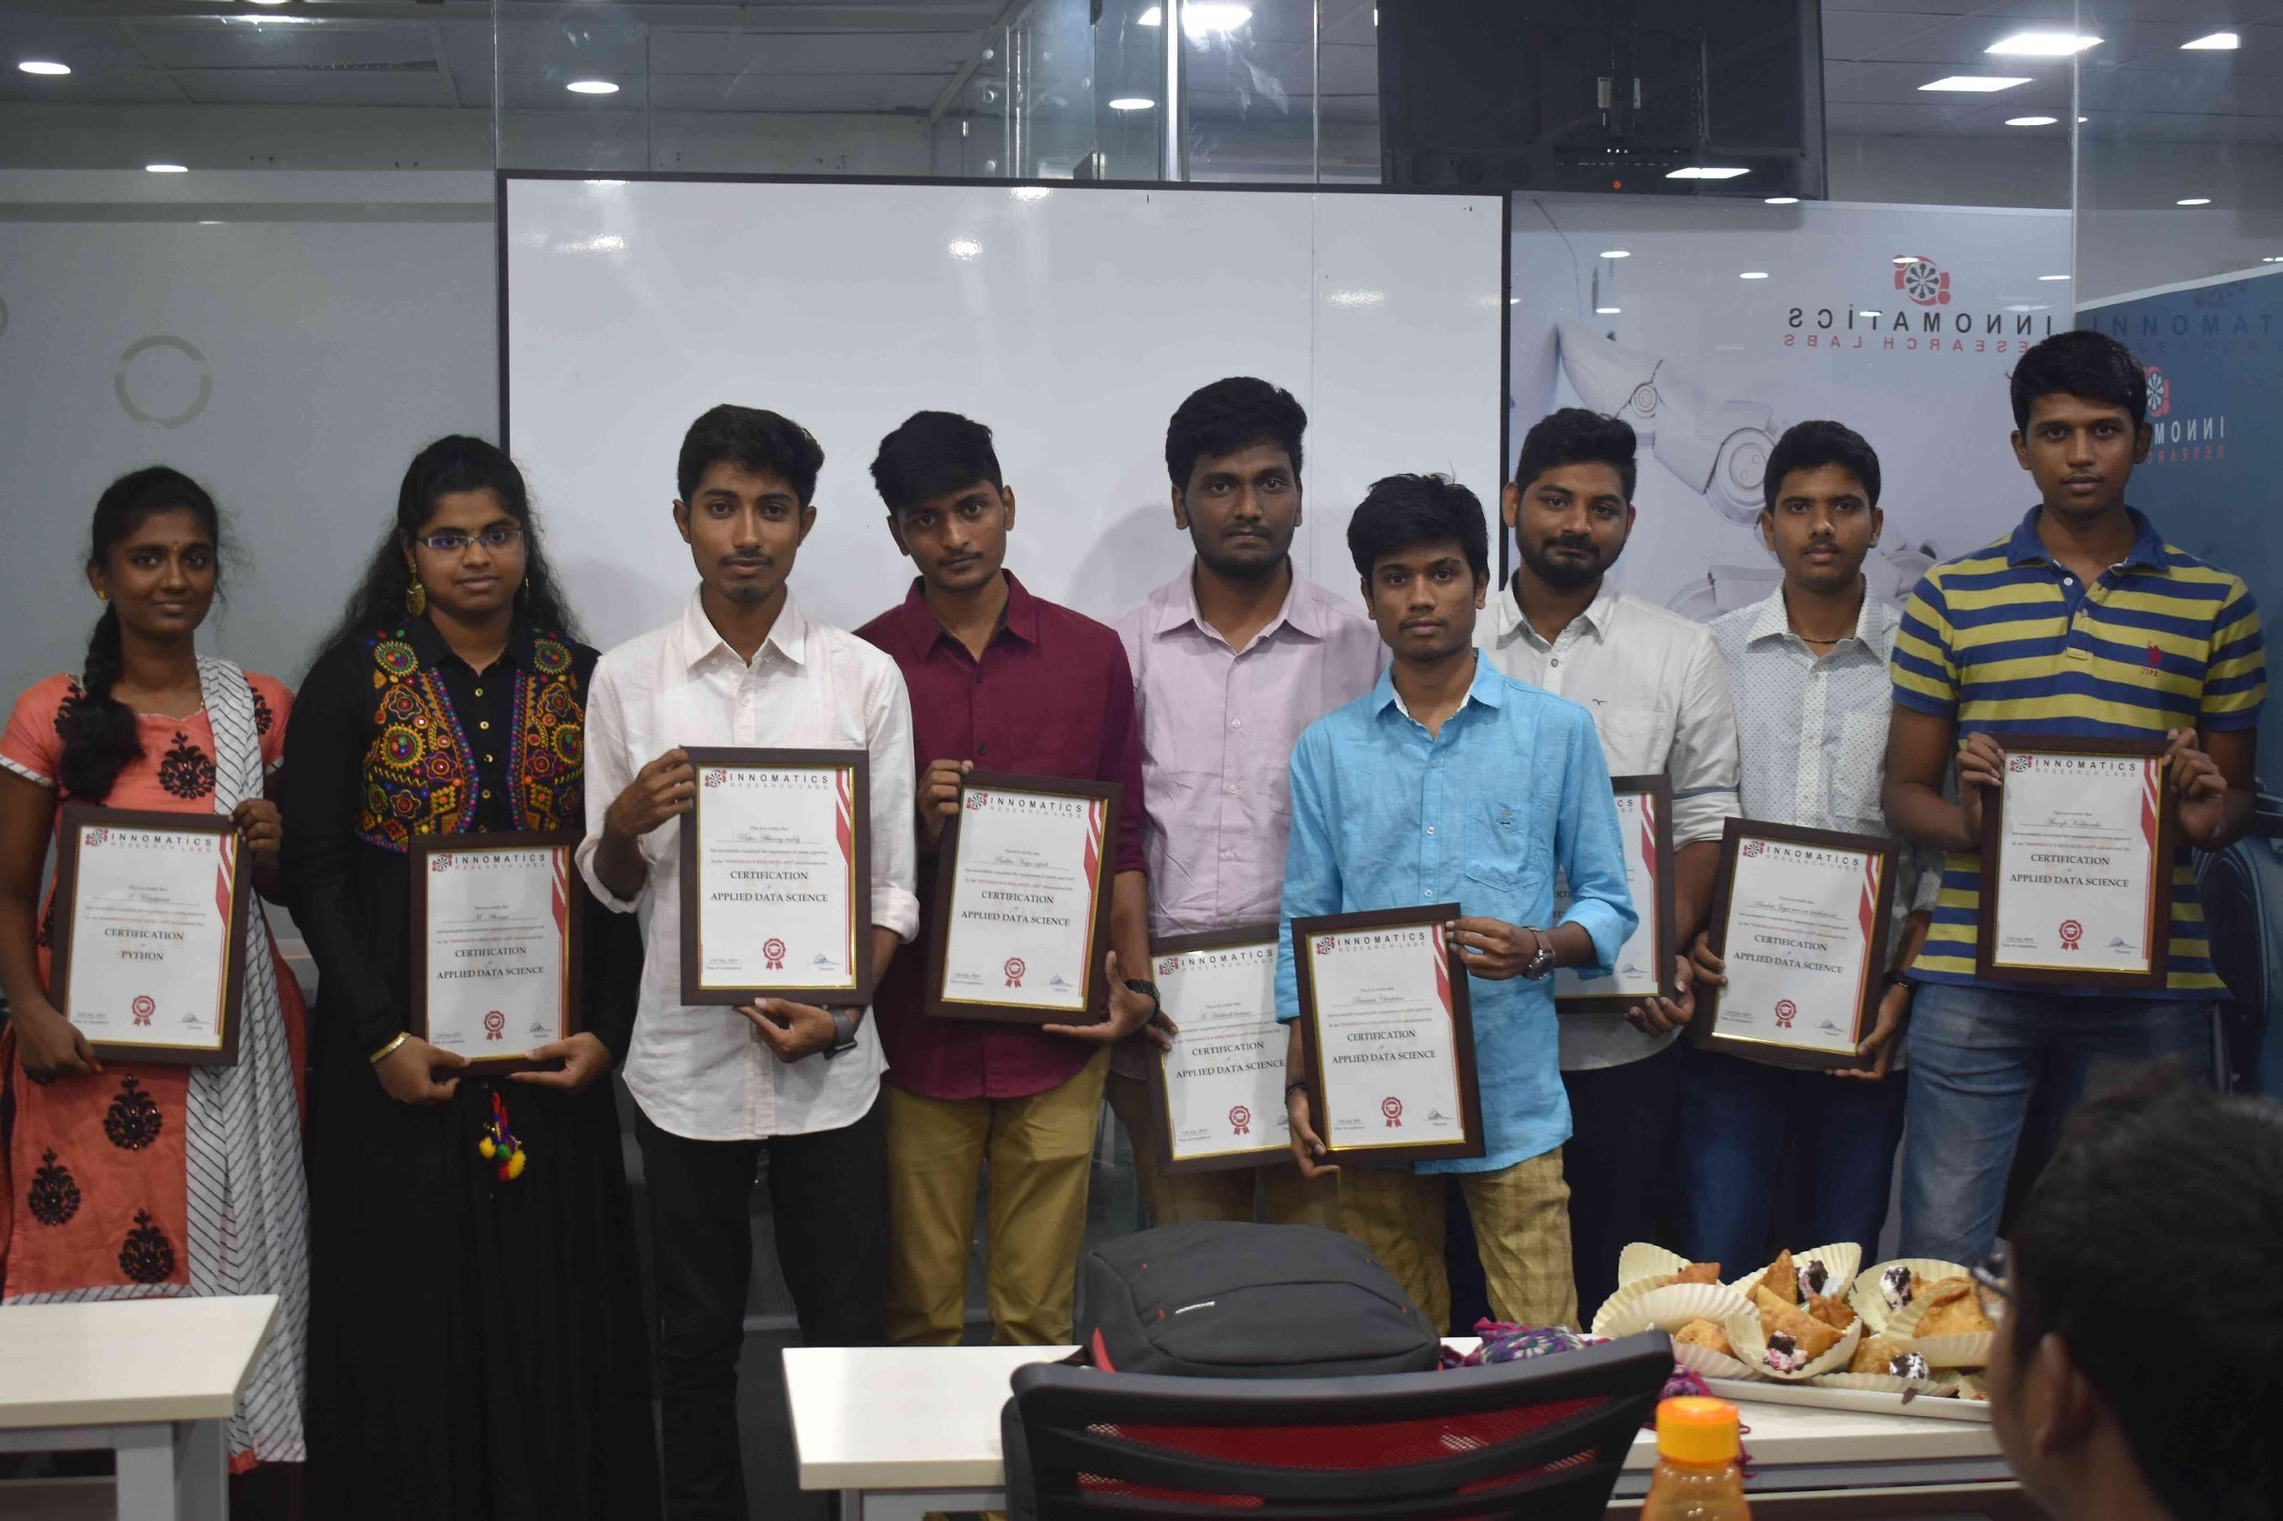
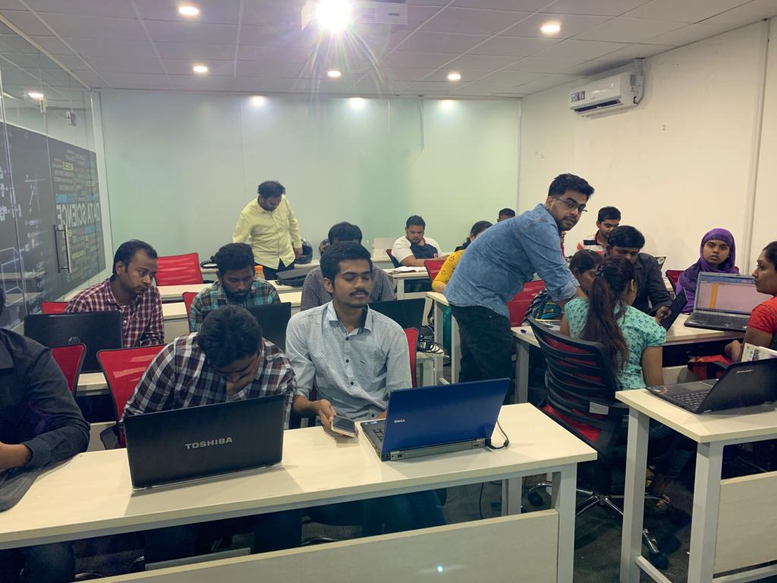

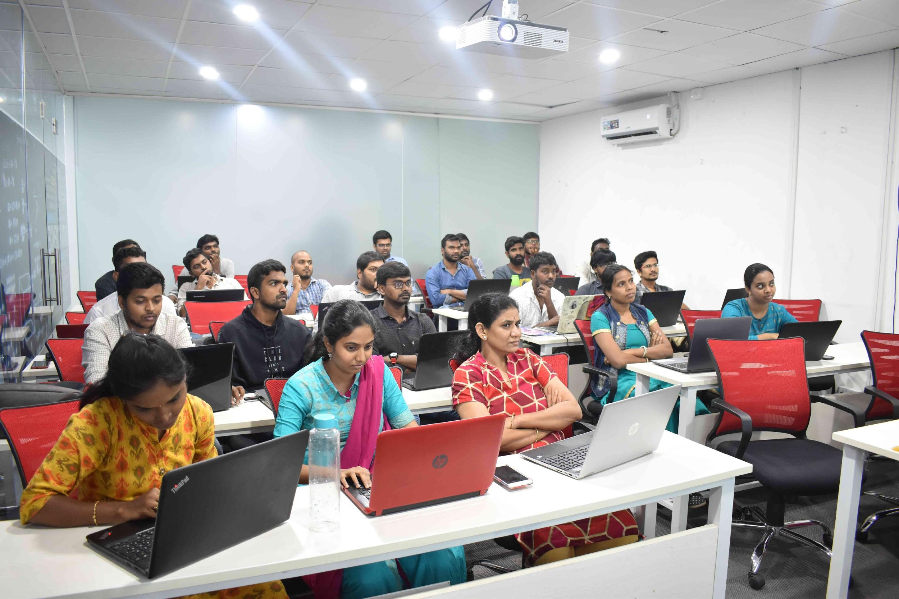
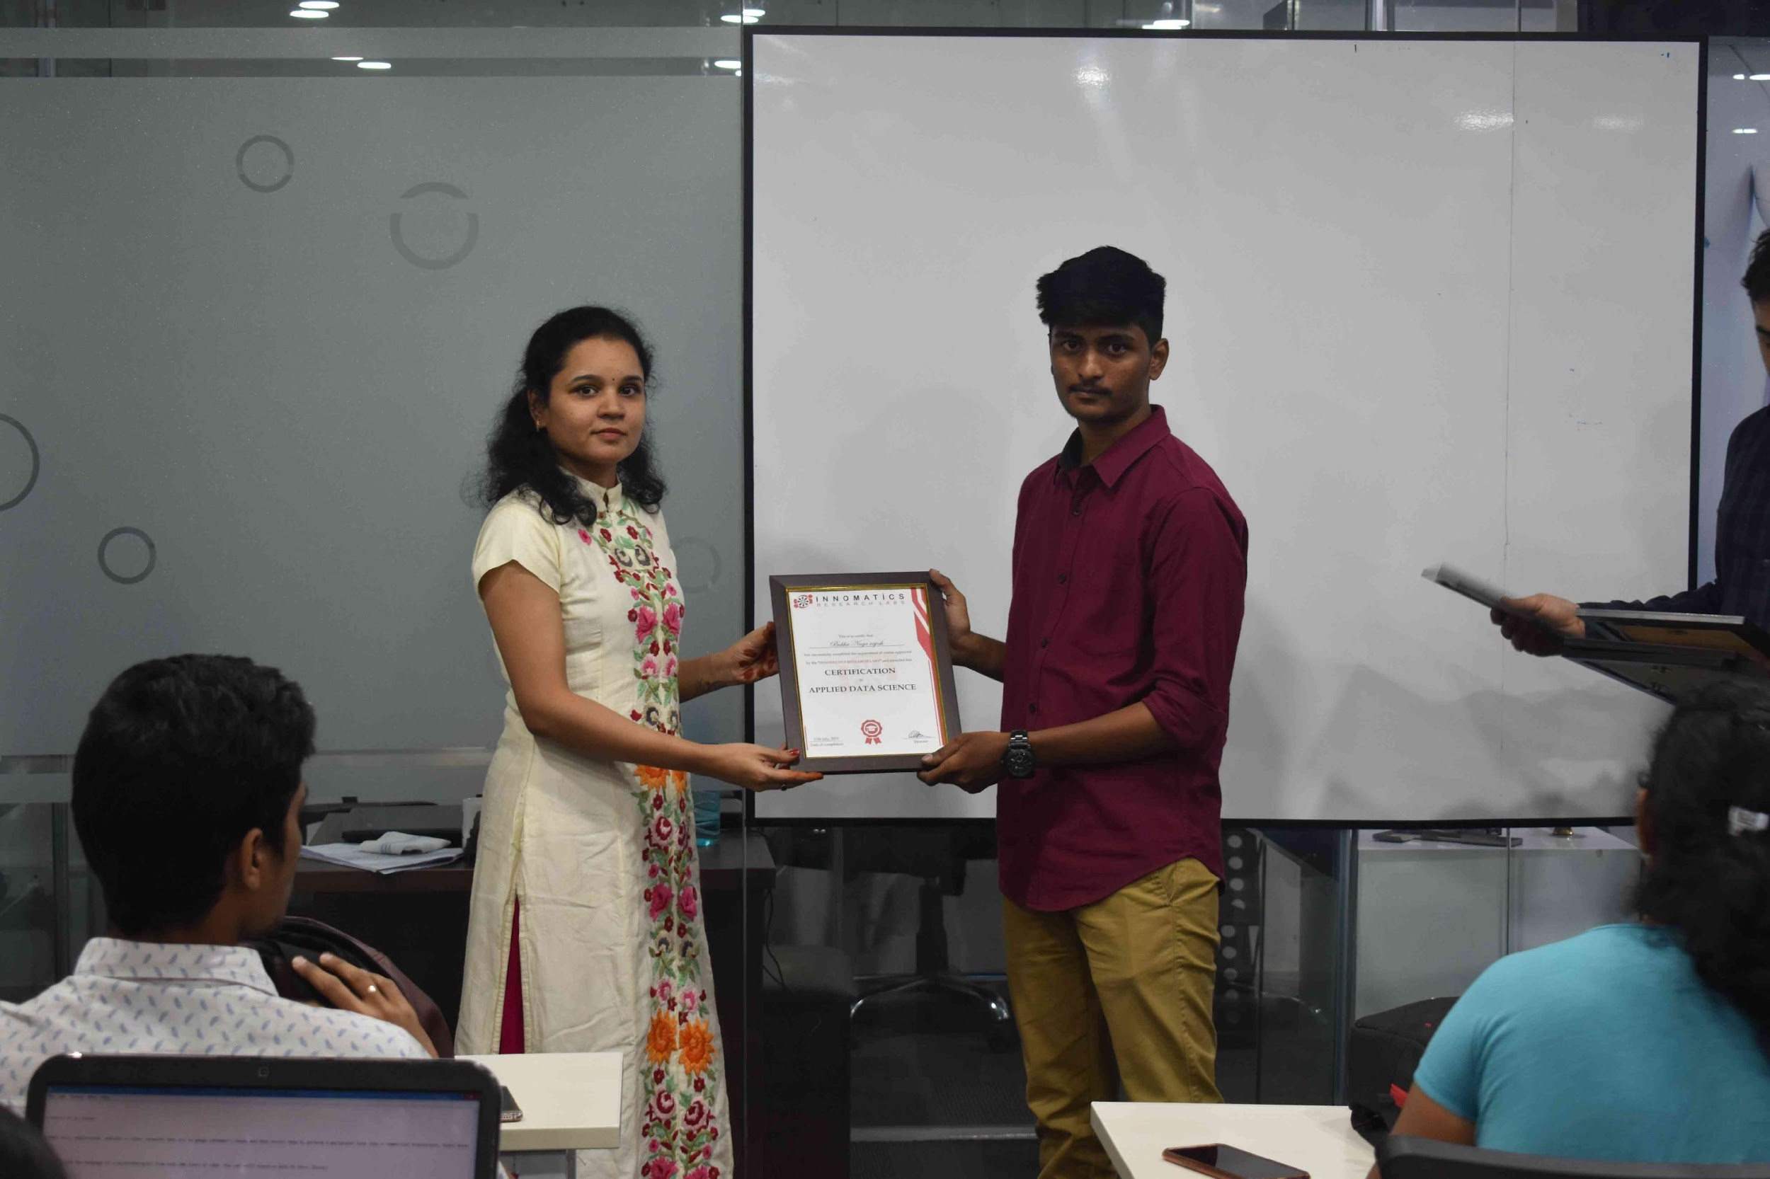
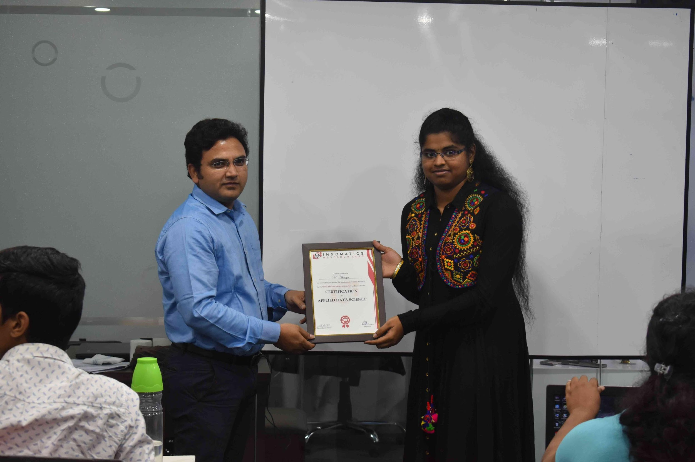

Slide 2

Giphy! Clone Web Application
By
G K S SHIVA TEJA

Slide 3
About me
Background ?
I am from B-tech (2022 Pass out) background perusing final year under Computer Science Engineering in Malla Reddy College of Engineering (Affiliated to JNTU)
Why you want to learn Full Stack Development Course
As the current industries is booming with the full stack developers and and also as it helps me gain skills on both frontend as well as backend development As a fresher I think that this will help me to start my career where I am able to work on both frontend as well as backend.
Any work experience
Currently I have no experience in the any company.
What like you about Innomatics Research lab
The way of teaching the skills regarding the full stack developer in innomatics is good.

Slide 4
Project Presentation Flow:
Project Title:
Giphy! Clone Web-Application
Project Description:
Giphy! Application provides the user with real life moving images called Gif’s(Graphics Interchange Format) and Stickers which can be used to share among various chatting or social media applications like whatsup, discord, etc… in response to users requirement like some people chatting in groups cannot express they’re feeling by just providing words But by using this Application user can share Gifs and stickers to express their expression in the form of known characters in real life.
Technologies Used:
HTML , CSS
Bootstrap 5
JavaScript, DOM
Ajax

Slide 5
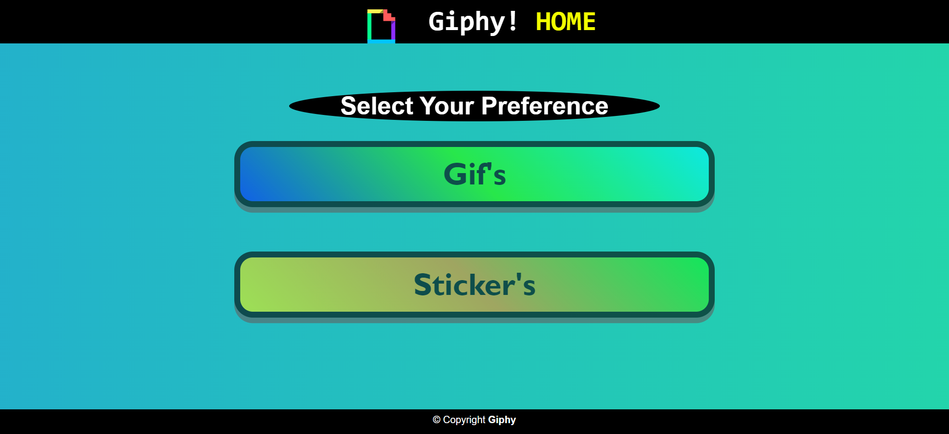
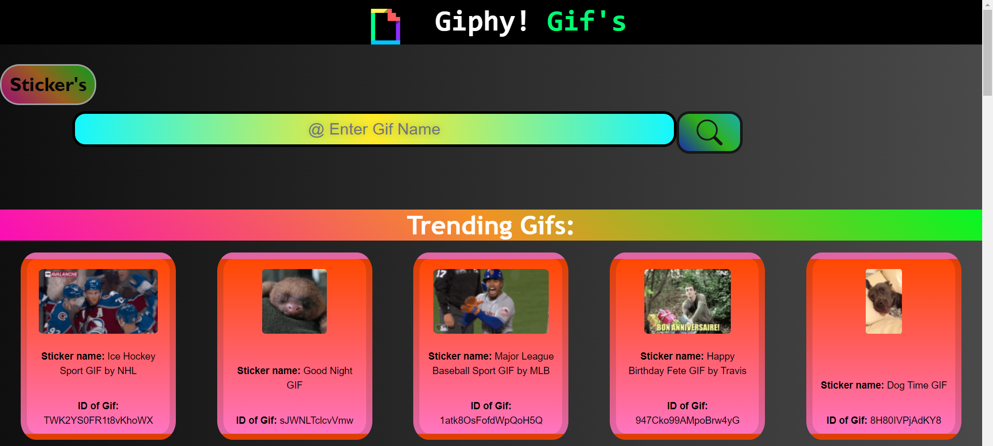
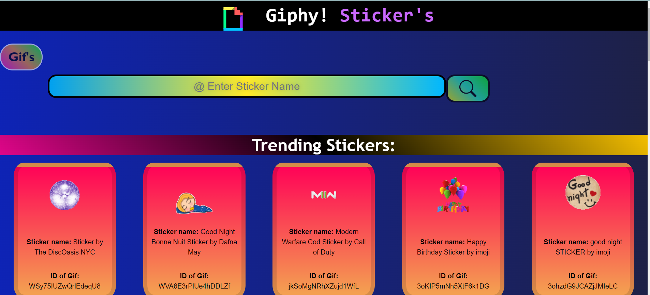
Screen shots of the application :

Slide 6
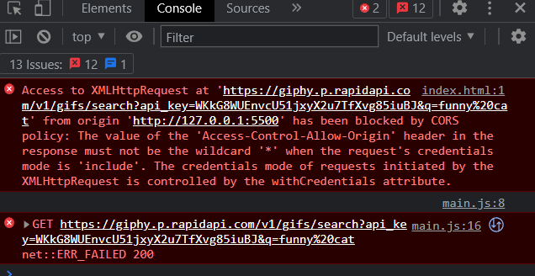
Project Presentation Flow:
Challenges in building the project:
Building this project was a bit challenging for me as it is an individual project which was being build by my self some fields very difficult to find the answers for so to overcome this problem I searched in the Google regarding my problem during building the project on Giphy! Application where I could find solutions for my problem & main problem I faced a CORS error where the data was not getting fetched to overcome that problem mentors guided me to solve the CORS (Cross-Origin Resource Sharing) error.

Slide 7
Experience in project building:
Building this project was fun it made me understand the how data can be accessed using Ajax using API building this project excites me regarding other projects which I’m have to build in the future this project help me gain knowledge and skills of things which I didn’t know while building the projects like different Styling methods.

Slide 8
Conclusion:
Finally I would like to conclude my project as these Gifs and stickers are used by many people nowadays in the social media applications which would help people express their feeling in the form of images and stickers instead of wasting time in typing an expression in the form of sentences.
The growth for usage of this application is possible in this current industries as well as in the near future.

Slide 9
References:
Rapid API - https://rapidapi.com/giphy/api/giphy/
Giphy Official Documentation - https://developers.giphy.com/docs/sdk/

Slide 10

THANK YOU
By
G K S SHIVA TEJA

